Slide 1
Explainable AI-Based Automated
Data Quality Management System
for Noise Detection in Numerical Data Pipelines
Presented by: Priya Dharshini V | II M. Sc Information Technology
Guide: Dr A. Akila M.C.A, M.Phil., Ph.D., | Associate Professor,
Department of Computer Science & Information Technology

Slide 2
Abstract
Data pipelines handling numerical data are vulnerable to hidden noise, outliers, and anomalies that degrade downstream analytics and model performance.
This project proposes an automated, modular Python-based system that detects noise using an ensemble of Isolation Forest, Local Outlier Factor (LOF), and One-Class SVM with consensus voting.
SHAP (SHapley Additive exPlanations) is integrated to provide feature-level interpretability, enabling users to understand why a data point was flagged as anomalous.
A Streamlit-based interactive dashboard allows CSV upload, anomaly visualisation, model comparison, and report download, making the system accessible to non-technical users.

Slide 3
Problem Statement
Numerical data pipelines frequently contain noise, missing values, and statistical outliers that silently corrupt analysis.
Existing anomaly detection methods operate as black boxes: they flag anomalies but provide no explanation of which features caused the detection or why.
Most existing systems require manual threshold specification and domain expertise.
There is a need for an end-to-end, automated, and interpretable data quality management system specifically designed for numerical data pipelines.

Slide 4
Existing System vs. Proposed System
Aspect | Existing Systems | Proposed System
Automation | Requires manual configuration per dataset | Fully automated modular pipeline
Explainability | No interpretability (black-box output) | SHAP-based feature-level explanations
Detection Approach | Single model, prone to high false positives | Ensemble (IF + LOF + SVM) with consensus voting
User Interface | No interface provided | Streamlit dashboard with upload & download
Scalability | Tightly coupled, hard to extend | Modular Python files, easily extensible
Contamination Threshold | Manual | Automated IQR-based estimation

Slide 5
Literature Review
Author & Year | Key Contribution | Research Gap
Lundberg & Lee (2017) | SHAP framework for unified feature attribution in ML models | Not evaluated on unsupervised anomaly detection pipelines
Zhang et al. (2022) | Ensemble anomaly detection combining IF and LOF for IoT sensor data | Lacks explainability layer; no user-facing interface provided
Chandola et al. (2021) | Comprehensive survey of anomaly detection techniques for numerical data | Does not address automated pipeline integration or XAI methods
Liu et al. (2012) | Isolation Forest for high-dimensional outlier detection | No consensus voting; single-model bias leads to false positives
Breunig et al. (2000) | Local Outlier Factor (LOF) for density-based local anomaly scoring | Sensitive to parameter choice; no ensemble or interpretability support
Scholkopf et al. (1999) | One-Class SVM for novelty detection in unlabelled datasets | Computationally heavy; not suitable as standalone pipeline solution

Slide 6
Objectives
Design a fully automated, modular Python pipeline for end-to-end noise detection in numerical CSV datasets without manual intervention.
Implement an ensemble anomaly detection mechanism using Isolation Forest, Local Outlier Factor, and One-Class SVM with a 2-out-of-3 consensus voting strategy.
Integrate SHAP explainability to generate feature-level interpretations (summary, dot, and waterfall plots) for every detected anomaly.
Develop a Streamlit-based interactive dashboard enabling non-technical users to upload data, visualise anomalies, compute data quality score, compare model outputs, and download results.
Evaluate detection quality using precision, recall, and F1-score with consensus output as the reference baseline in an unsupervised setting.

Slide 7
Methodology
01
Data Ingestion
Load numerical CSV; validate schema; write raw data to SQLite via data_ingestion.py
02
Preprocessing
Impute missing values, scale features, enforce column types via preprocessor.py
03
Ensemble Detection
Apply Isolation Forest, LOF, One-Class SVM independently; flag anomalies per model
04
Consensus Voting
Label a point anomalous only if at least 2 of 3 models agree, reduces false positives
05
SHAP Explainability
Compute SHAP values; generate summary, dot, and waterfall visualisations via explainer.py
06
Dashboard & Report
Streamlit app.py: upload, process, visualise, compare models, and download flagged CSV results

Slide 8
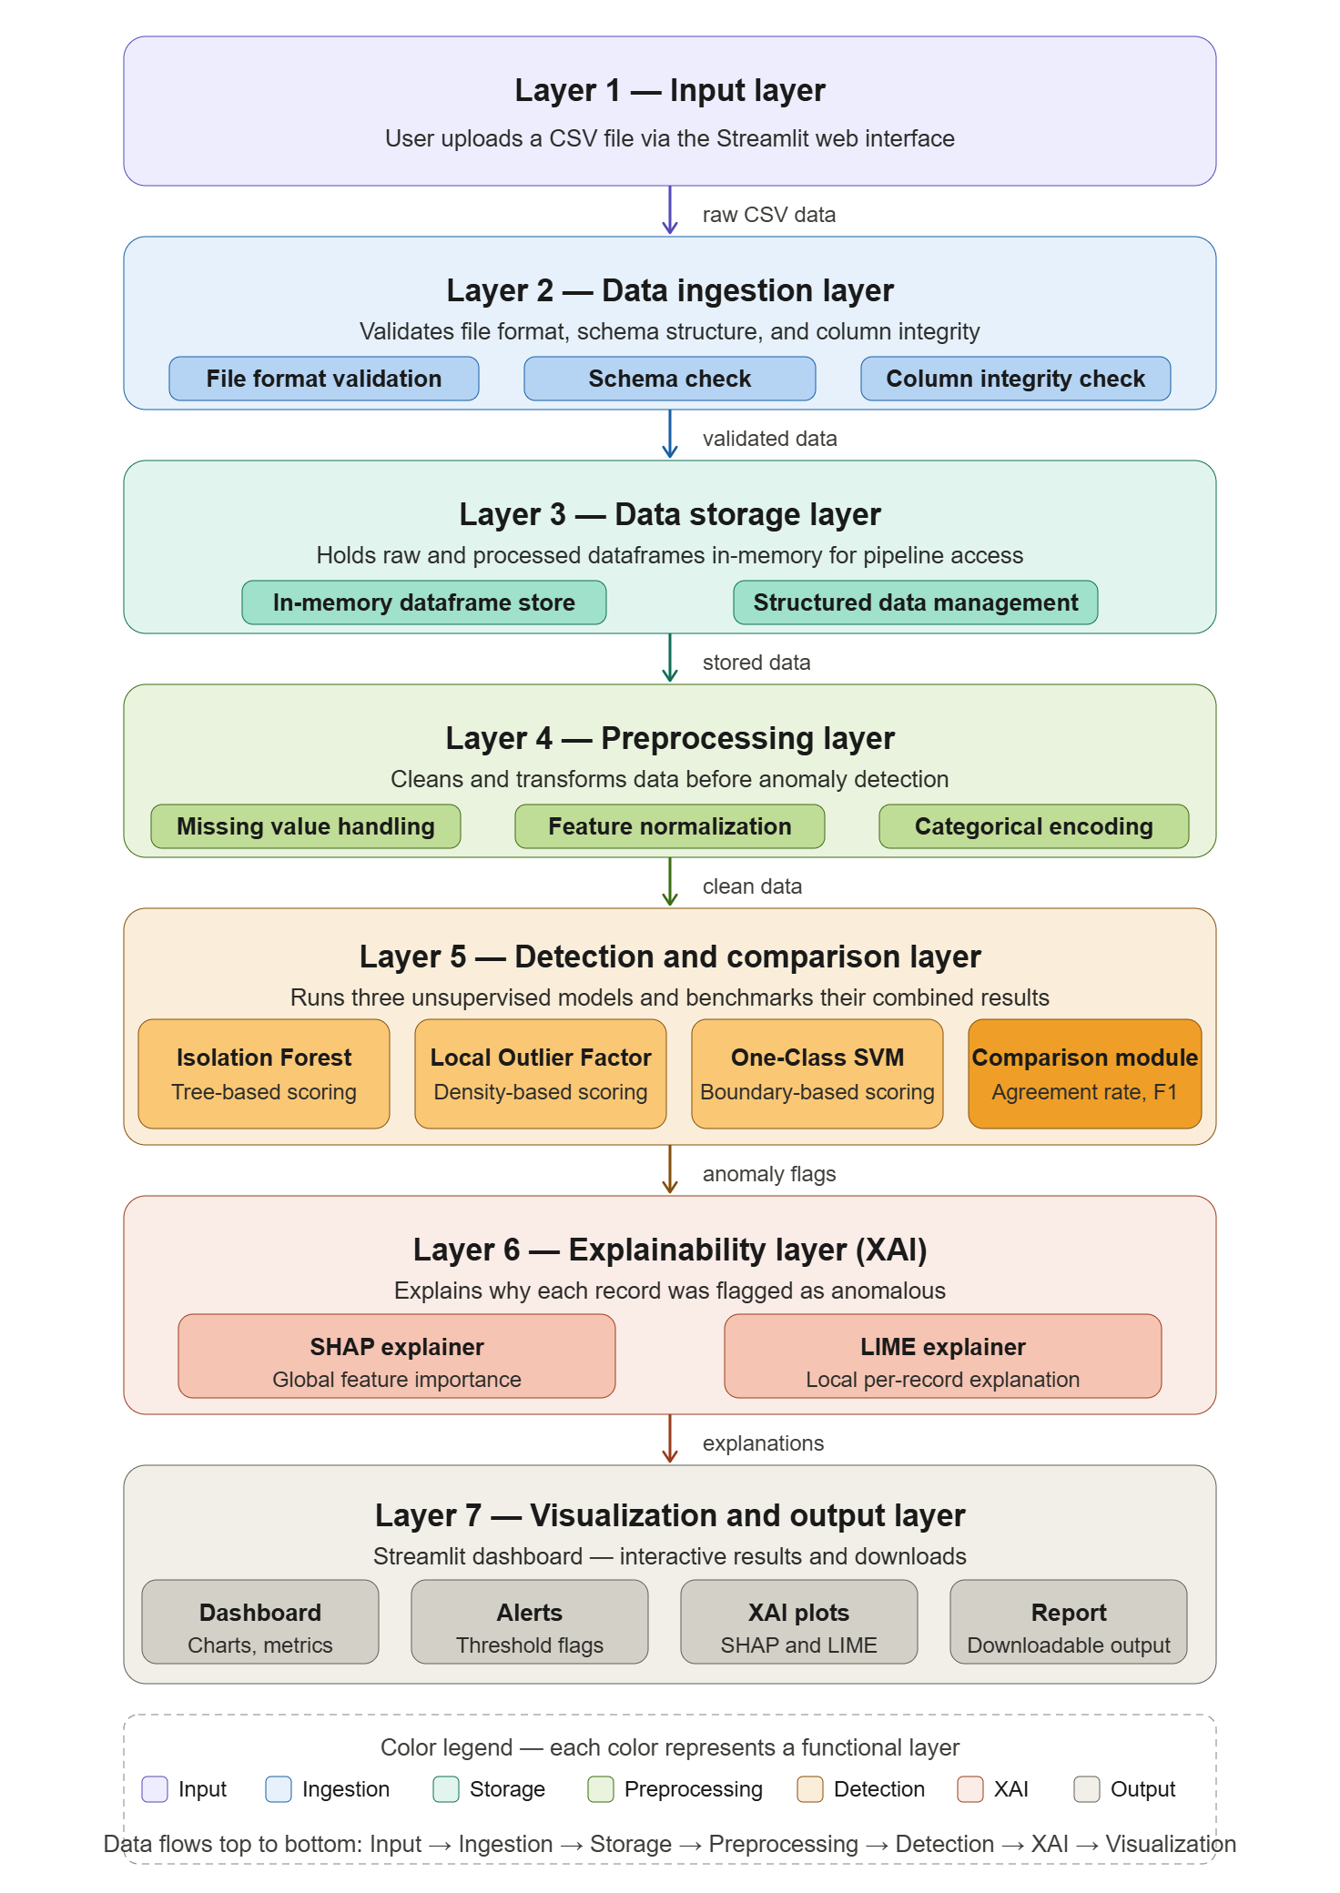
System Architecture

Slide 9
Implementation - Data Layer Modules (1/3)
Data Ingestion
Accepts any numerical CSV file uploaded through the Streamlit interface.
Validates column data types
Writes validated raw data to a dedicated SQLite table for persistent storage.
Data Storage
Manages the SQLite database schema for the entire pipeline.
Maintains two core tables: raw_data (original CSV records) and processed_data (after preprocessing).
Provides read/write utility functions used by ingestion, preprocessing, and detection modules.
Preprocessing
Reads raw data from SQLite and applies median imputation for all missing (NaN) values.
Standard Scaler to normalise all numerical features to zero mean and unit variance.
Writes the cleaned and scaled dataset back to the processed_data table in SQLite.

Slide 10
Implementation - Detection & Comparison Modules (2/3)
Ensemble Detection
Loads the preprocessed dataset from SQLite and independently runs all three ML models.
Isolation Forest: tree-based, isolates anomalies by random feature partitioning, shorter path = higher anomaly score.
Local Outlier Factor (LOF): density-based, compares the local density of a point to k-nearest neighbours.
One-Class SVM: learns a boundary around normal data; points outside the boundary are labelled anomalous
Consensus Voting
Aggregates the three binary label columns produced by the detection module into a single results table.
Applies the 2-out-of-3 consensus voting rule: a point is anomalous only if at least 2 models agree.
Computes precision, recall, and F1-score for each model against the consensus baseline.
Generates a side-by-side model comparison summary table used by the Streamlit dashboard for display.

Slide 11
Implementation - Explainability & Dashboard Modules (3/3)
SHAP Explainability
Uses SHAP's TreeExplainer for Isolation Forest and KernelExplainer for LOF and One-Class SVM.
Computes SHAP values for every flagged anomaly, quantifying each feature's positive or negative contribution to the anomaly score.
Summary Plot: ranks all features by mean absolute SHAP.
Dot Plot: shows individual-level SHAP values per feature.
Waterfall Plot: provides a local explanation for a single data point.
Streamlit Dashboard
Serves as the user-facing entry point; the user uploads a CSV file directly through the browser interface.
Automatically triggers the full pipeline on upload.
Displays anomaly count, model-wise results table, data quality score, bar chart of metrics, and all three SHAP plots.
Allows users to download the flagged anomaly records along with their consensus label as a CSV report.

Slide 12
Machine Learning Models Used
Isolation Forest
Local Outlier Factor (LOF)
One-Class SVM
Tree-based algorithm that isolates anomalies by randomly partitioning feature space.
Anomalies require fewer splits to isolate, shorter average path length = higher anomaly score.
Effective for high-dimensional numerical data with low memory and computational overhead.
Trained exclusively on normal data; learns a decision boundary enclosing the majority class.
Points falling outside the learned boundary are classified as anomalies (novelties).
Robust to class imbalance, ideal for unlabelled datasets where anomalies are rare.
Density-based method that compares the local density of a point to its k-nearest neighbours.
Points in low-density regions relative to their neighbours receive a high LOF score.
Captures local contextual anomalies that global methods such as Isolation Forest may miss.

Slide 13
Consensus Voting Mechanism
Each of the three models independently labels every data point as normal (0) or anomalous (1).
A data point is confirmed anomalous only if at least 2 out of 3 models agree, this is the consensus voting rule.
Consensus voting reduces false positives caused by model-specific bias and improves overall detection reliability.
The consensus output serves as the reference baseline for computing precision, recall, and F1-score.
Data Point | Isolation Forest | LOF | One-Class SVM | Consensus Label
Point A | Anomaly | Normal | Anomaly | ANOMALY
Point B | Normal | Normal | Anomaly | NORMAL
Point C | Anomaly | Anomaly | Anomaly | ANOMALY

Slide 14
SHAP-Based Explainability
SHAP (SHapley Additive exPlanations) assigns each feature a contribution value that quantifies how much it pushed a prediction toward or away from the anomaly class.
Summary Plot: displays all features ranked by mean absolute SHAP value, providing a global view of which features most influence anomaly detection across the dataset.
Dot Plot: shows individual SHAP values for every data point per feature, revealing directional impact, whether a high or low feature value drives anomaly classification.
Waterfall Plot: provides a local, instance-level explanation showing how each feature contributed to the anomaly score of a single flagged data point.
Integrating SHAP transforms the system from a black-box detector into a transparent, interpretable, and audit-ready data quality tool.

Slide 15
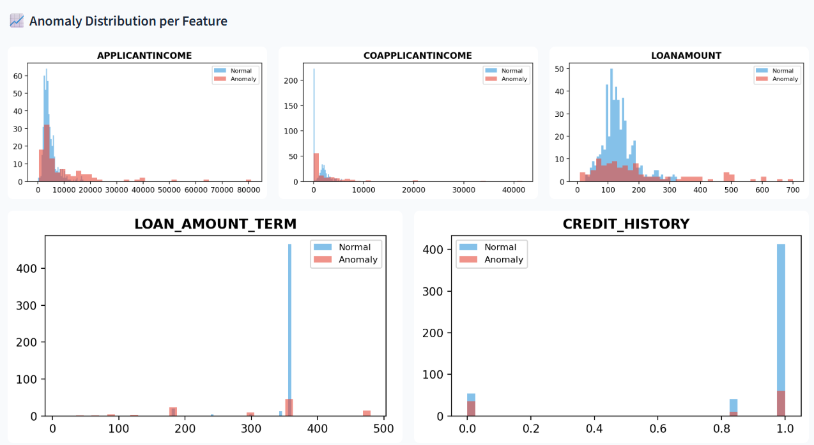
SHAP-Based Explainability (Cotn.,)

Slide 16
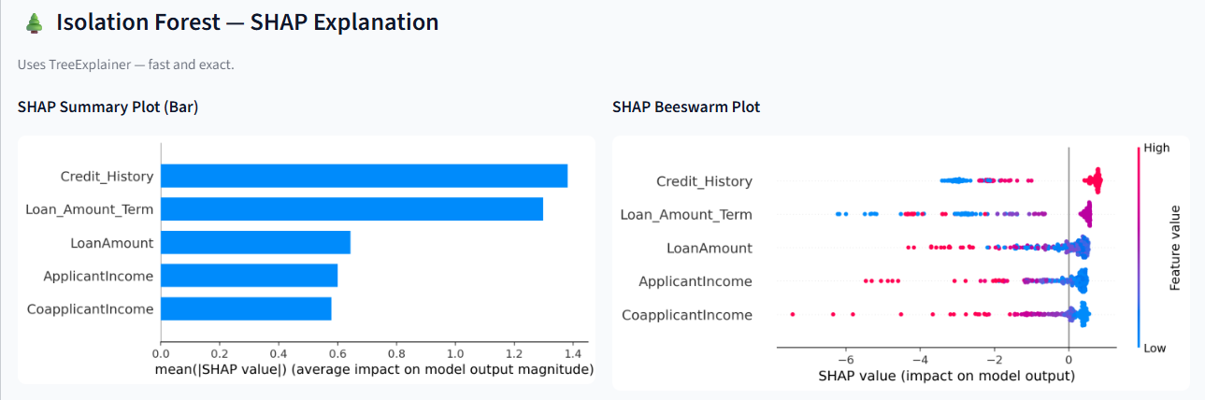
SHAP-Based Explainability (Cotn.,)

Slide 17
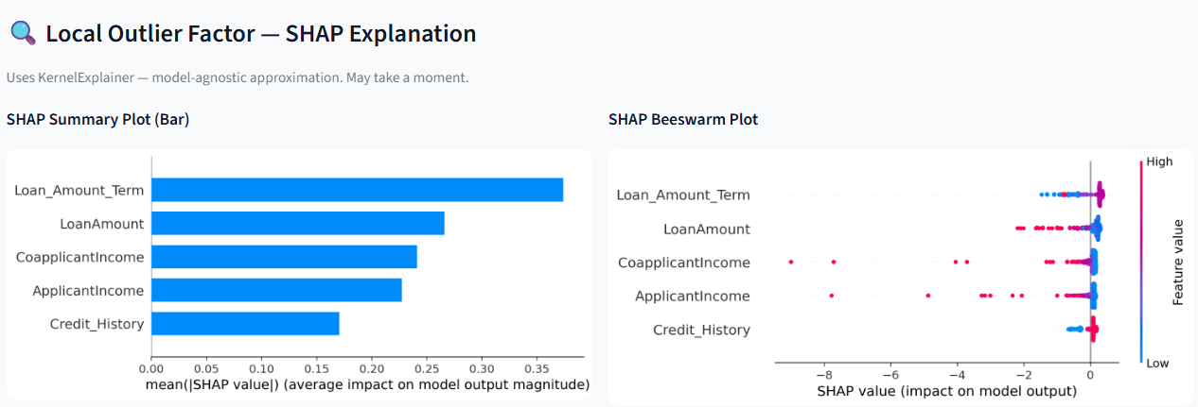
SHAP-Based Explainability (Cotn.,)

Slide 18
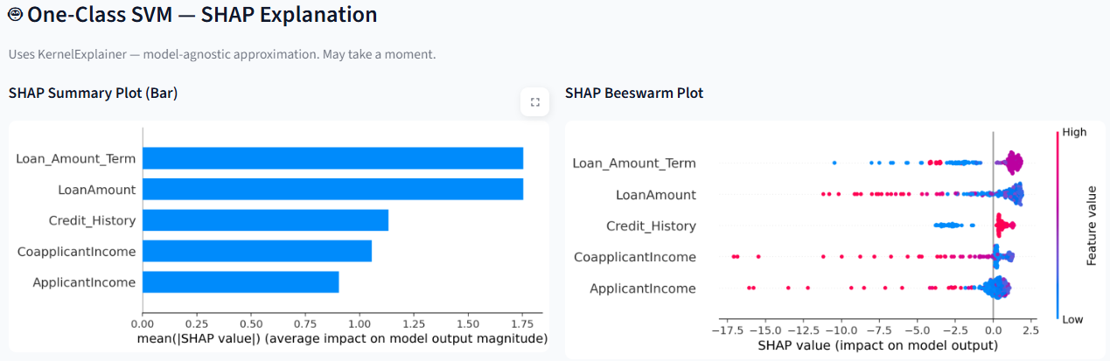
SHAP-Based Explainability (Cotn.,)

Slide 19
Evaluation Metrics
Precision
Recall
F1-Score
TP / (TP + FP)
TP / (TP + FN)
2 × P × R / (P + R)
High precision means fewer false alarms.
High recall means fewer missed anomalies.
Overall balance.
Each model (IF, LOF, SVM) is evaluated against the consensus label to assess agreement and detect under-performing models.

Slide 20
Results and Output
614 records
149 missing values
106 consensus anomalies
Quality Score = 90.6%

Slide 21
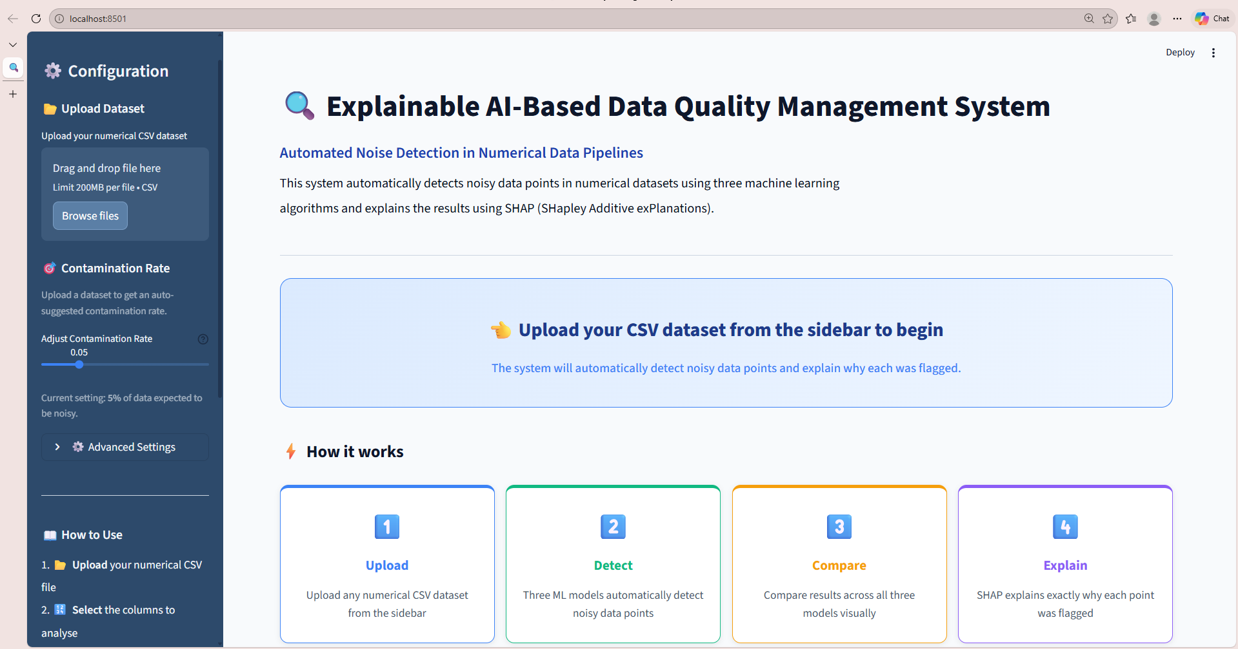
System Interface - Streamlit Dashboard

Slide 22
System Interface - Streamlit Dashboard (Contn.)
Users can upload any numerical CSV file; the pipeline auto-validates, preprocesses, and runs all three models without any manual configuration.
The dashboard renders side-by-side model comparison charts and interactive SHAP plots (summary, dot, waterfall) directly in the browser.
Flagged anomaly records with their consensus label and SHAP values can be downloaded as a CSV report for audit and review.

Slide 23
Conclusion
A fully automated, end-to-end data quality management system was successfully designed and implemented for noise detection in numerical data pipelines.
The ensemble approach combining Isolation Forest, LOF, and One-Class SVM with 2-out-of-3 consensus voting delivers higher accuracy and robustness than any single model alone.
Integration of SHAP explainability bridges the gap between algorithmic detection and human-interpretable insight, making the system transparent and audit-ready.
The Streamlit dashboard provides a practical, accessible interface that enables non-technical stakeholders to use the system without programming knowledge.
This project contributes a reusable, modular, and extensible pipeline architecture applicable to any numerical CSV dataset across domains such as IoT, healthcare, and industrial monitoring.

Slide 24
Future Scope
Cloud Deployment
Real-Time Streaming Pipeline
Deploy the Streamlit application on AWS, GCP, or Azure to enable remote, multi-user access at scale.
Integrate cloud-based object storage (e.g., AWS S3) for persistent dataset management and result archiving.
Containerise the pipeline using Docker and orchestrate with Kubernetes for production-grade reliability and scalability.
Integrate Apache Kafka as a streaming data ingestion layer to process live feeds in real time.
Replace batch SQLite storage with Apache Spark Structured Streaming for high-throughput, low-latency processing.
Extend the SHAP explainability module to generate live anomaly explanations as data streams through the pipeline.

Slide 25
THANK YOU

